Slide 1
BG: The curious case with the licensing of the ISPs
“If you want the government to solve your problem, make it a problem of the government”, Ivan Kostov, Prime-Minister

Slide 2
1998 - 1999
Government introduces licenses for the ISP
Internet Society files a case at the Supreme Administrative Court
  Biggest problem: find a lawyer
  10 months of PR campaign
  Hundreds of publications in all media
  International support

Slide 3
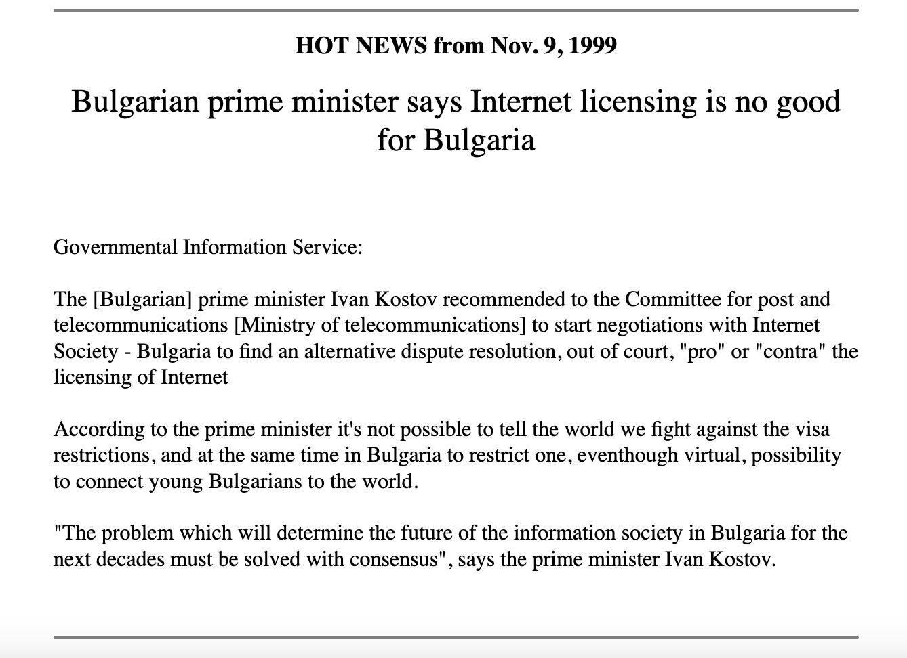
Some evidence

Slide 4

Some evidence

Slide 5
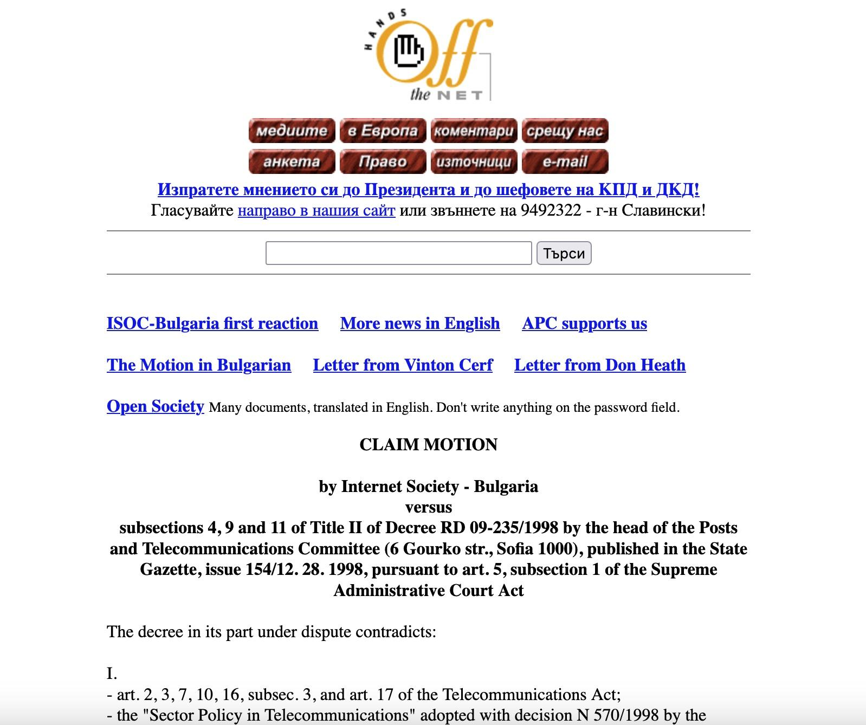
Some evidence

Slide 6
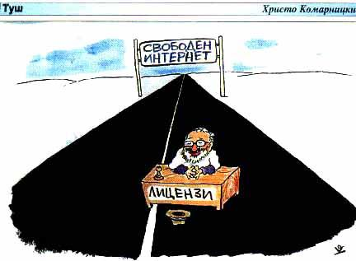
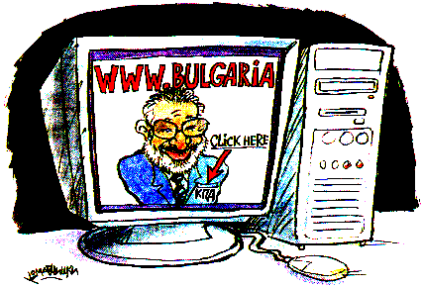
Some evidence

Slide 7
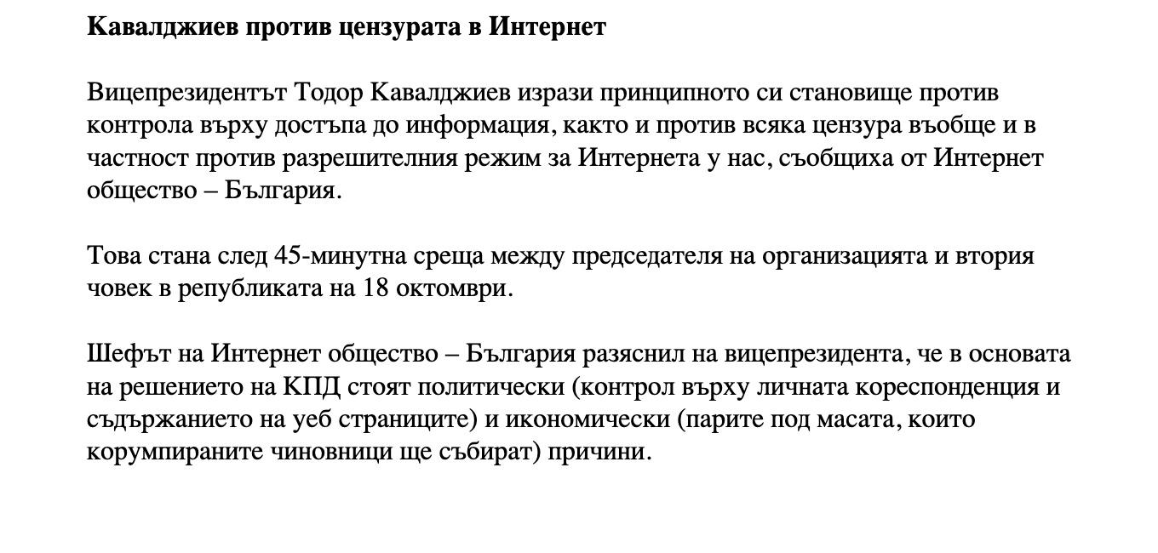
Some evidence

Slide 8
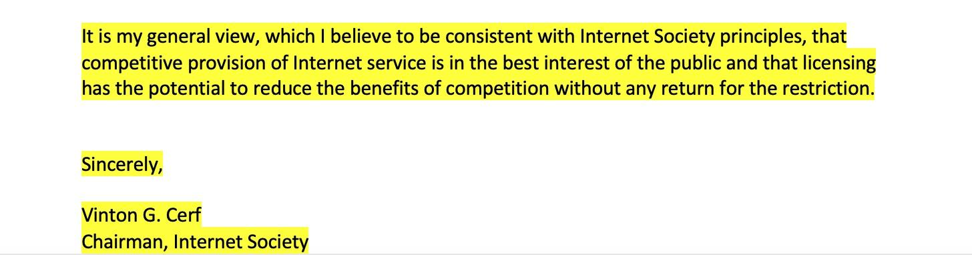
Some evidence

Slide 9
Conclusions
We won, despite the whole government machine
We won, despite some ISPs applying for a license
We won, because we were right
Our win was a win for all ISPs and all Internet users in Bulgaria

Slide 10
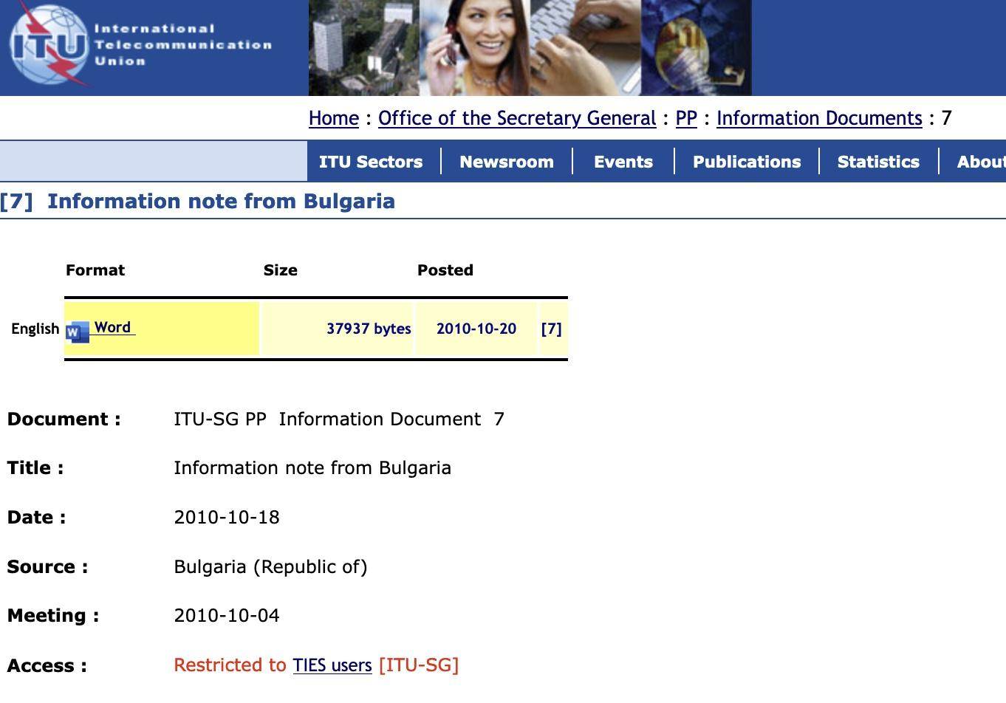
Conclusions

Slide 11
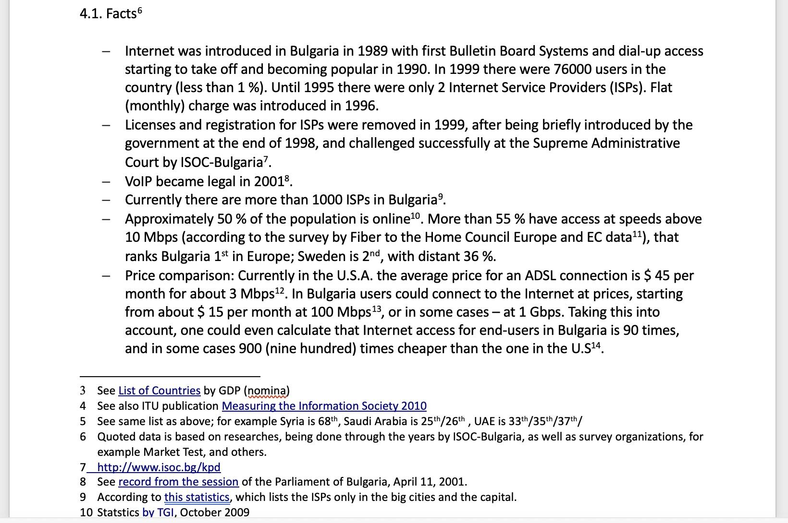
Conclusions

Slide 12
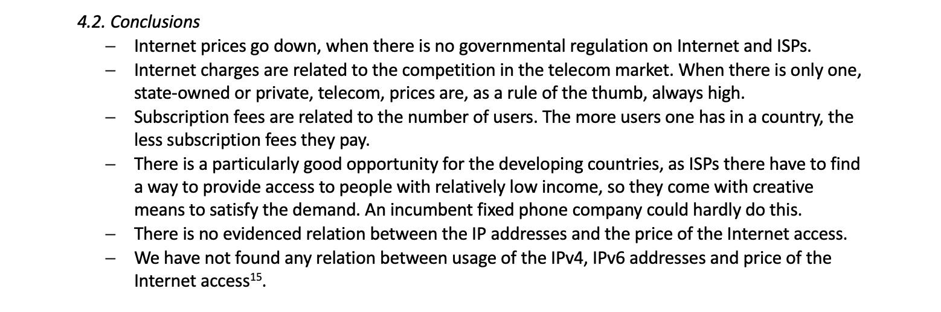
Conclusions

Slide 13
Questions?
Thank you!

